Slide 1
Paid MFT Internships
Get Hours. Get Paid.
Presenter: Robin Andersen

Slide 2
Who Am I?
Owner and creator of Paid MFT Internships
I am currently working at Vista Hill’s Juvenile Drug Court program as a PAID MFT registered intern
I graduated from Pepperdine University in 2013, moved back to San Diego County, and began looking for internships with no connections to utilize
I used Craigslist to find 3 of my 4 internships
Prior to this position, I worked at:
The Elizabeth Hospice (unpaid)
San Diego Center for Neurofeedback (stipend)
Mental Health Systems (paid)

Slide 3
How Did We Get Started?
In August 2015, I was done with my 3000 hours and getting ready to transfer out of two internships in favor of my new position at Vista Hill
I was approached by numerous colleagues and friends who wanted to know how I found my position at Vista Hill, and how they could find paid internships
I rattled off names of various employers and suggested they check out job listing websites… but I walked away wondering if there was more I could do

Slide 4
How Did We Get Started?
After doing some research, I found that there were no centralized places on the internet for finding paid MFT internships
One website had attempted this (and more), but shut down years ago when they could not sustain themselves
As a self-taught web developer, I began to wonder if there was a way for me to create a job listing website specifically for MFT registered interns
Thus, Paid MFT Internships was born on September 1, 2015!

Slide 5
What Is It?
Paid MFT Internships (PaidMFTInternships.com) is a free job listing service for MFT registered interns and employers who hire MFT registered interns!
All job listings on Paid MFT Internships:
Are PAID positions
Offer HOURS toward licensure
We cover all of Southern California and large portions of Central and Northern California
Most job listings are for large companies, agencies, schools, hospitals, etc.; however, we also have job listings for private practices

Slide 6
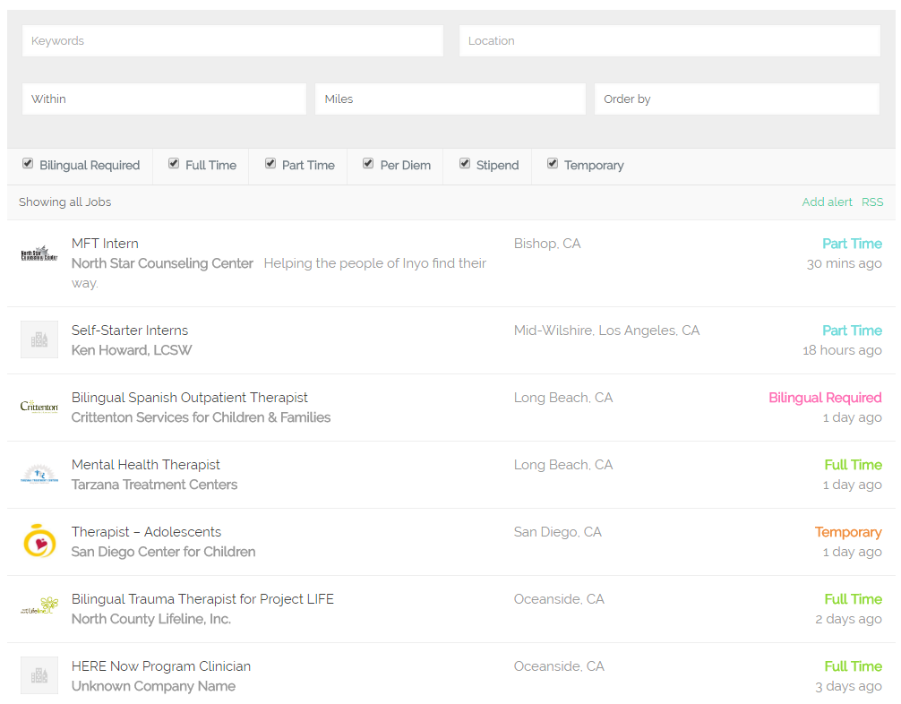
Job Search

Slide 7
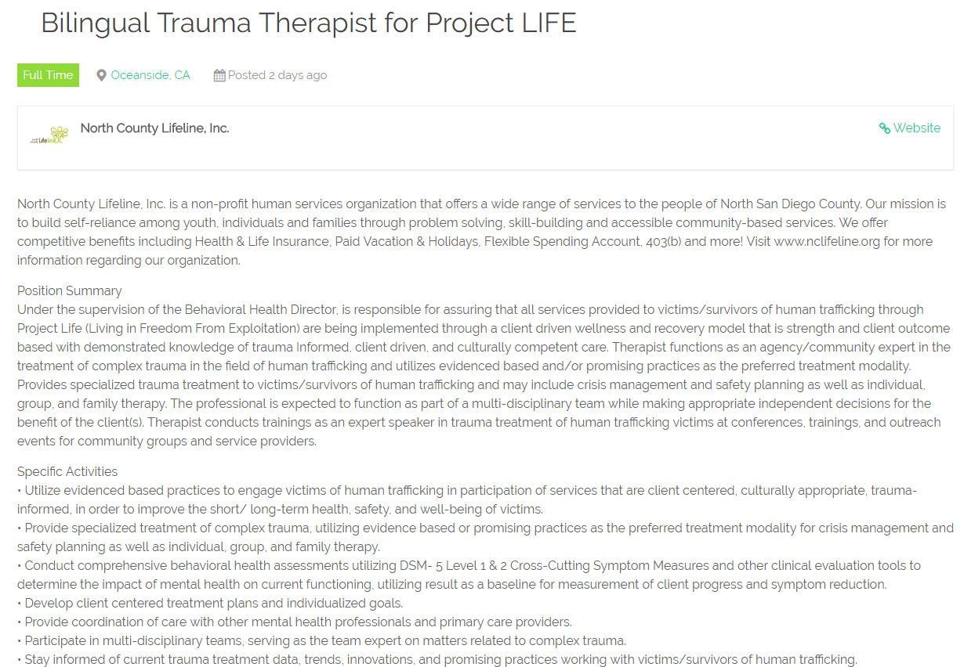
Job Listing

Slide 8
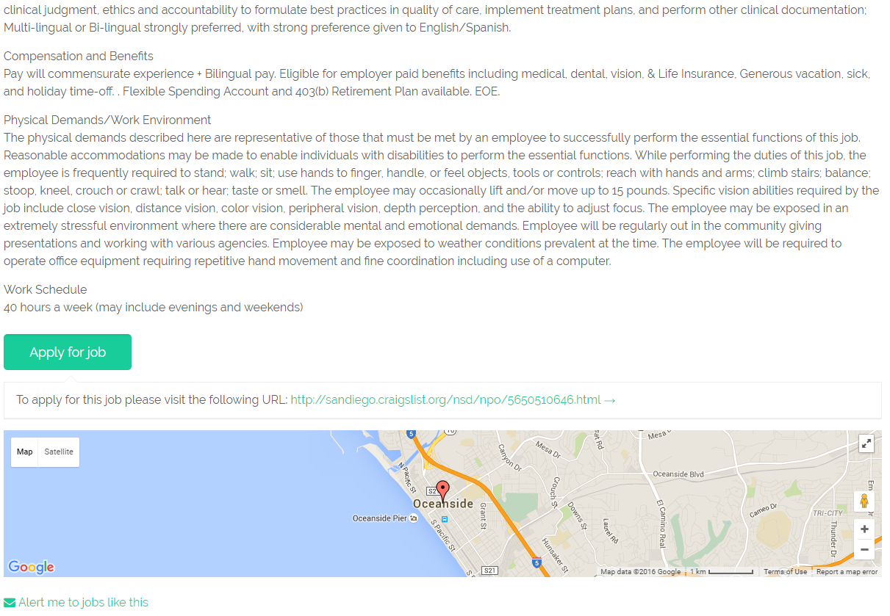
Job Listing

Slide 9
Examples of Local Job Listings
Carlsbad job listings have been posted by:
Montecatini
San Diego Center for Children
West Coast Recovery Centers
Oceanside job listings have been posted by:
Community Research Foundation
Mental Health Systems
North County Lifeline
Pacific Palms Recovery
Rady Children’s Hospital

Slide 10
How Does It Work?
Paid MFT Internships locates job listings and posts them on its website and social media pages
Followers on Facebook, Twitter, and LinkedIn receive notifications when new job listings are posted
We are currently testing an e-mail alert feature as well
Anyone can submit a job listing using our simple online form (PaidMFTInternships.com/Post)
All submitted job listings are posted within 24 hours
It’s free to submit job listings!

Slide 11
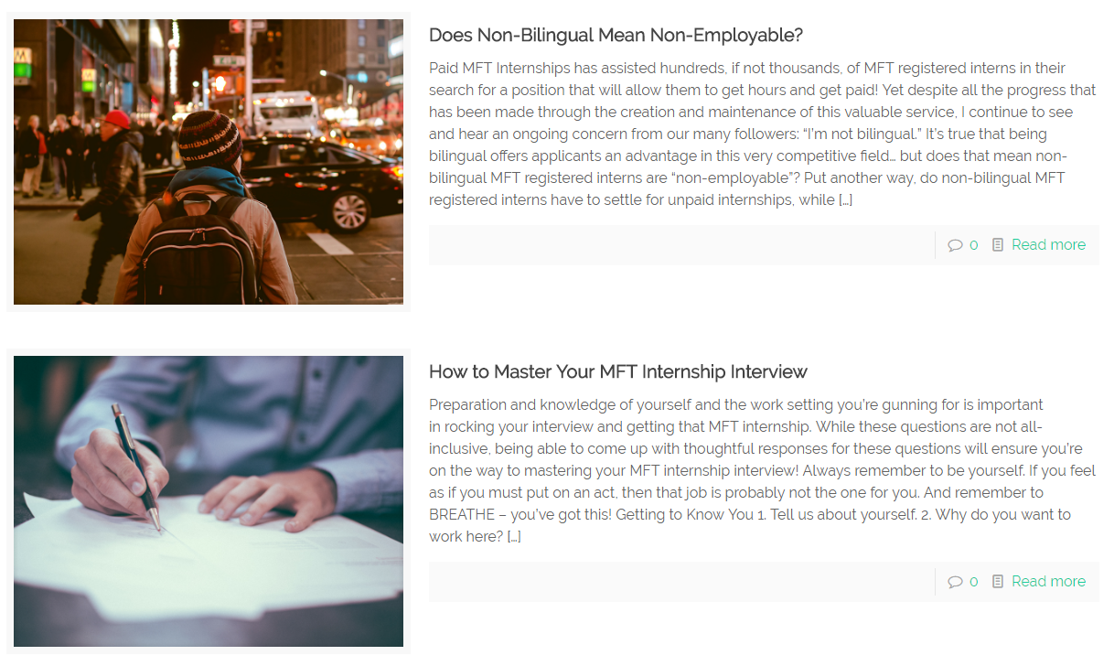
Blog Articles

Slide 12
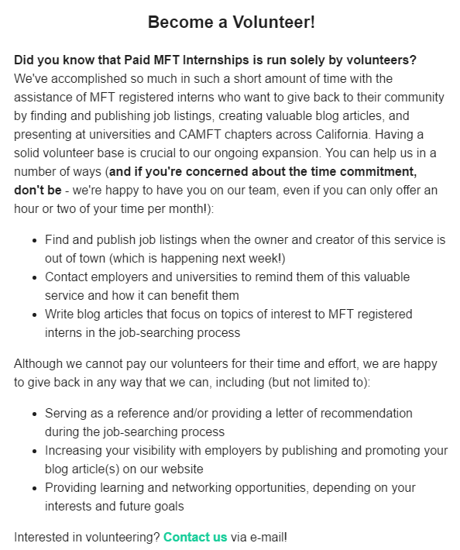
Newsletter

Slide 13
Challenges We’ve Faced
Small team of volunteers
Confusing terminology in job listings
“License eligible” vs. “licensed waivered” vs. “pre-licensed”
“Therapist” vs. “Counselor” vs. “Intern” vs. “Trainee”
Titles that state one thing, but descriptions state another
Employers’ lack of participation
Not responding to outreach e-mails and phone calls
Not understanding the value of this service

Slide 14
What’s Next?
Our summer plan is ambitious:
Cover the entirety of California by the end of the summer!
Reach out to more universities so that incoming students will be aware of this service well before graduation time
Ramp up our efforts to create a solid volunteer base
You can support our growth in a number of ways:
Consider volunteering, even if just 1-2 hours per month
Spread the word about this valuable service
If you obtain a job through this service, let us know!

Slide 15
Wait, Is This Really Free?
Short answer: YES!
Long answer:
Interns: You have already accrued more than your fair share of expenses while earning your Master’s degree. You will continue to pay for registration renewals, study prep materials, workshops/trainings, etc. We don’t believe it’s fair to charge you a subscription fee in order to access these job listings. Yes, this service is free for you.
Employers: Thank you for paying MFT registered interns. We are more than happy to share your job listings with our followers. Yes, this service is free for you as well.

Slide 16
How Did It Get Started?
In August 2015, I realized the following:
Nothing like this existed
Something like this needed to exist
I had the ability to create this
In September 2015, Paid MFT Internships was launched and word began to spread to interns
Nine months later, Paid MFT Internships is growing at an exponential rate!

Slide 17
What Have I Learned From This?
There ARE paid internships – and lots of them!
It IS possible to stand out in our field when you:
Explore what gaps exist in our field
Focus on your non-clinical strengths
Step outside of your comfort zone
Like-minded people WILL support you if they believe in you and what you are trying to accomplish
We have a long way to go if we want paid internships to become the norm in California

Slide 18
What’s Next?
Paid MFT Internships’ long-term goal is to include job listings for all of California, and even other states!
We want to work with other advocates in the field to push for more recognition of MFT registered interns and the struggles they encounter
You can support Paid MFT Internships by following us on social media and/or subscribing to our e-mail newsletter, spreading the word to interns and employers alike, and becoming a volunteer!

Slide 19
Questions?

Slide 20
Robin Andersen
Owner and Creator
of Paid MFT Internships
Robin@PaidMFTInternships.com

